Slide 1
An Intelligent Software defined Network Controller for preventing Distributed Denial of Service Attack

Slide 2
Introduction
SDN is presently is one of the most focused area among contemporary emerging network computing paradigms and gaining wide acceptance from both fraternity of academia and industry.

Slide 3
Abstract
Software Defined Network (SDN) architecture is a new and novel way of network management mechanism. In SDN, switches do not process the incoming packets like conventional network computing environment.

Slide 4
Existing System
SDN is presently is one of the most focused area among contemporary emerging network computing paradigms and gaining wide acceptance from both fraternity of academia and industry.

Slide 5
Disadvantages
Performance measure is low
Detecting packets are not fully satisfied
Low accuracy

Slide 6
Proposed System
In this paper a machine learning based intelligent method is proposed which can detect the incoming packets as infected or not.

Slide 7
Advantages
1. High accuracy
2. It’s correctly identified to an infected class to total number of infected samples.
3. Here the generated data are interpreted and understood

Slide 8
Design-UML Diagrams

Slide 9
Class Diagram

Slide 10
Use case Diagram

Slide 11
Sequence Diagram

Slide 12
Collaboration Diagram

Slide 13
Component Diagram

Slide 14
Deployment Diagram

Slide 15
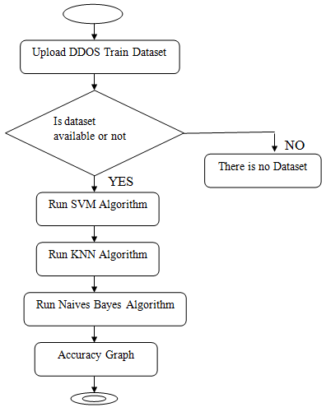
Activity Diagram

Slide 16
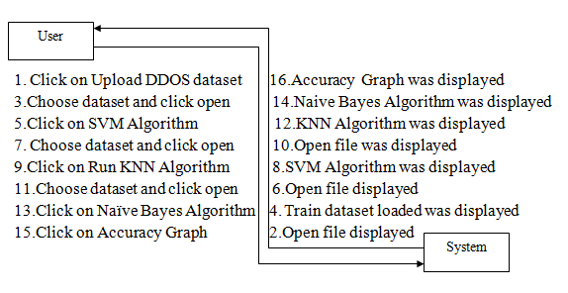
Dataflow Diagram

Slide 17
Hardware Requirements
Processor - Pentium –IV
Speed - 1.1 GHz
RAM - 256 MB(min)
Hard Disk - 20 GB
Key Board - Standard Windows Keyboard
Mouse - Two or Three Button Mouse
Monitor - SVGA

Slide 18
Software Requirements
Operating System : Windows XP
Programming Language : Java

Slide 19
Output Screens

Slide 20
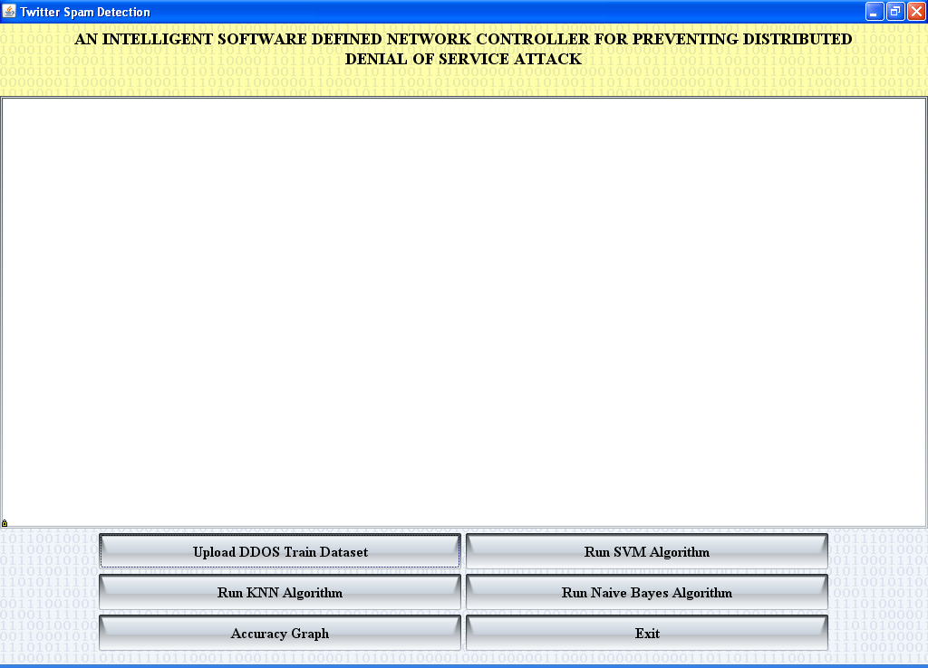

Slide 21
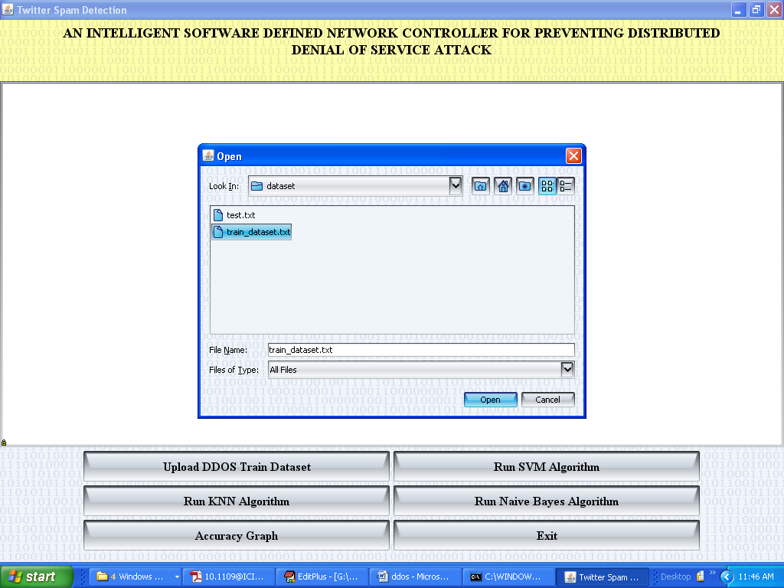
Upload file Screen

Slide 22
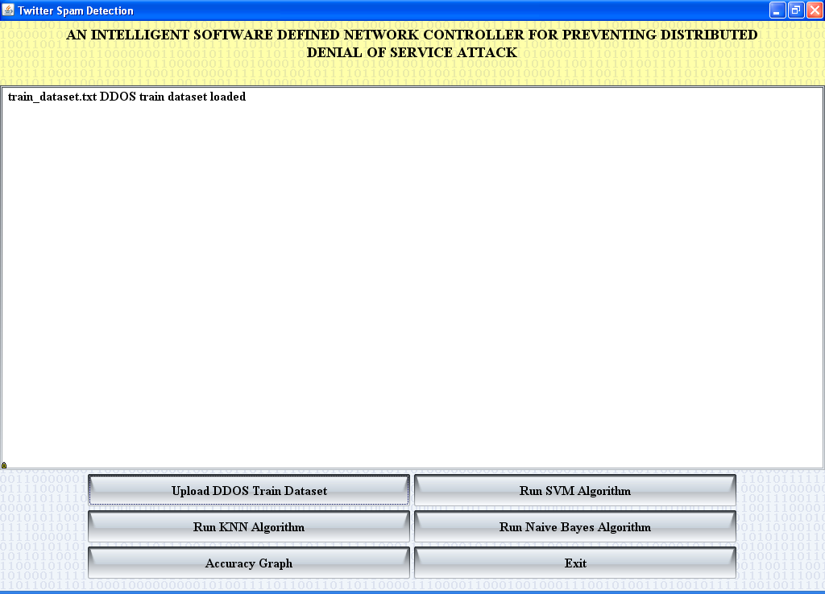

Slide 23
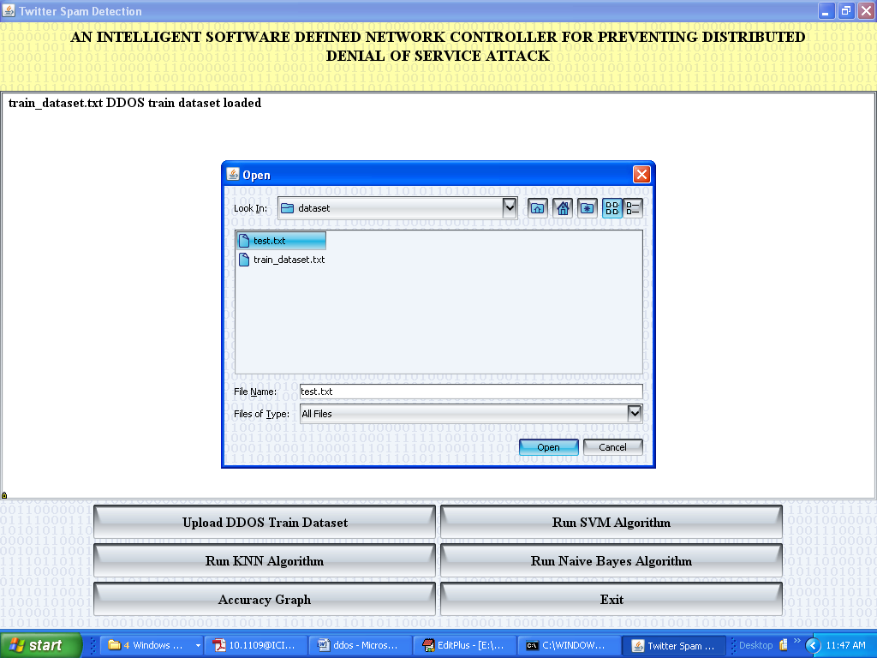

Slide 24
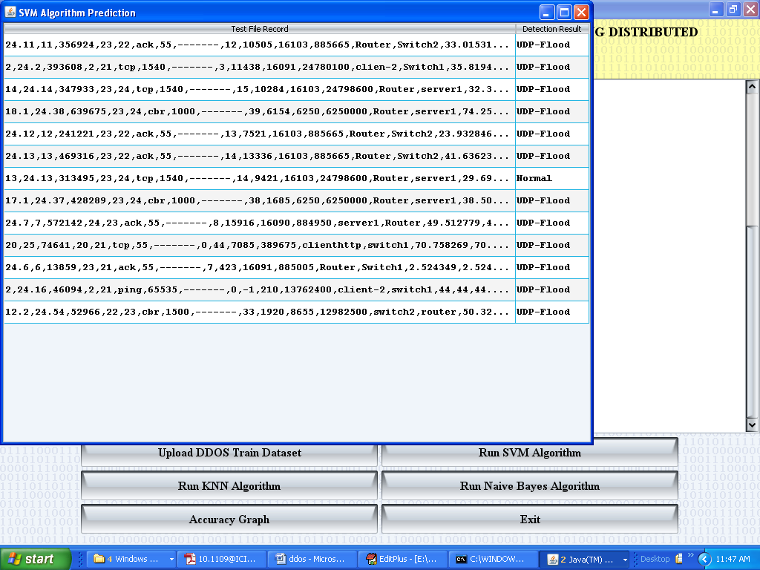

Slide 25
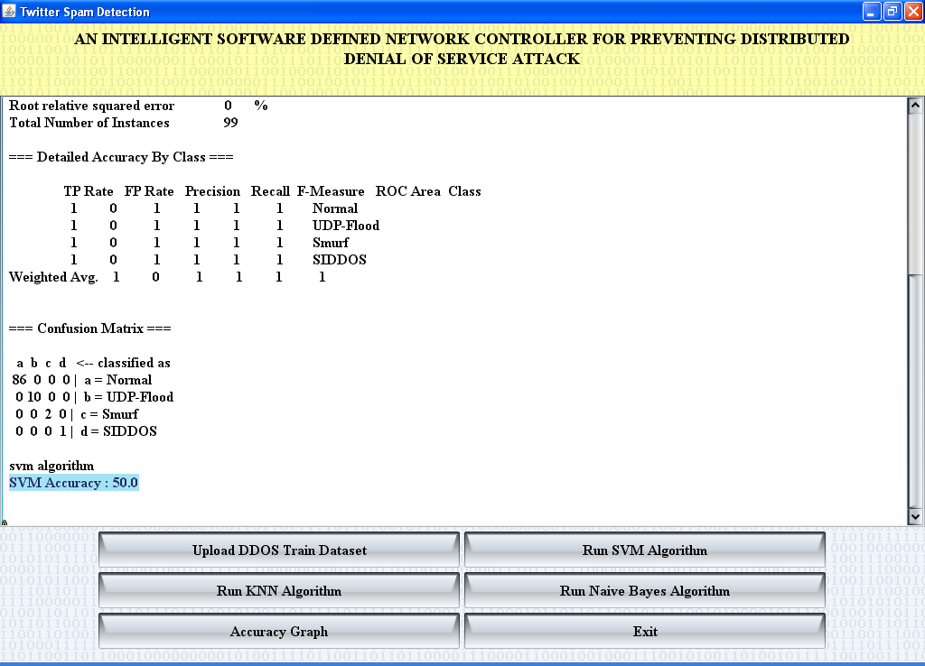

Slide 26
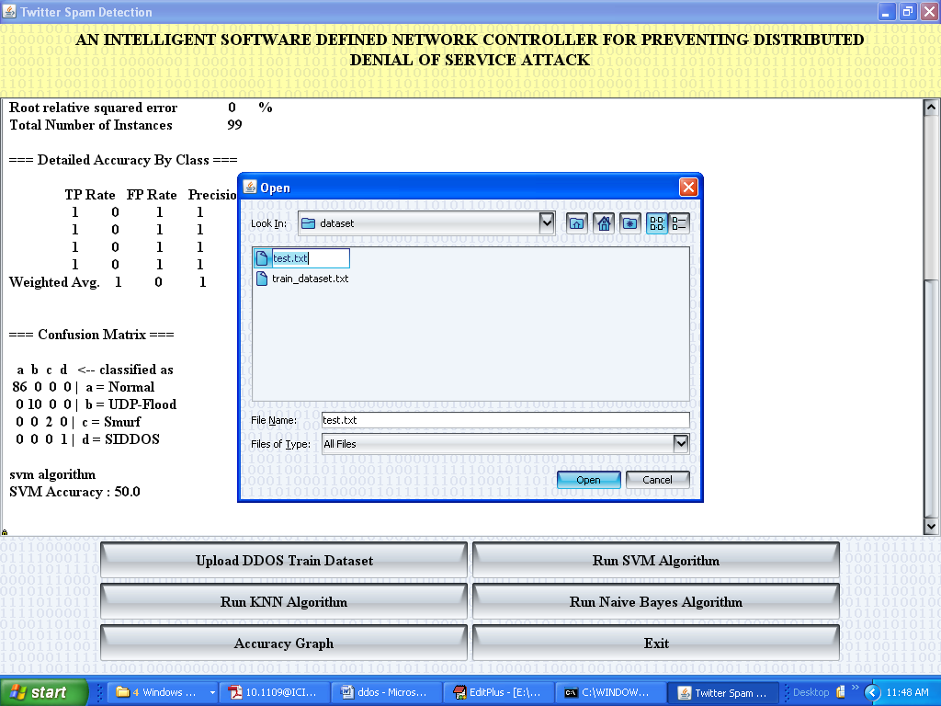

Slide 27
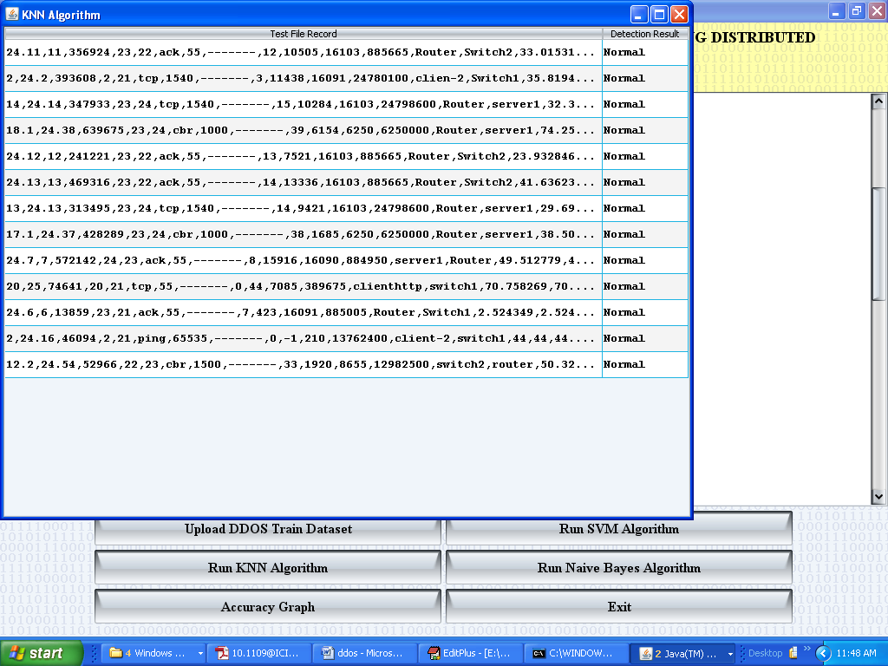

Slide 28
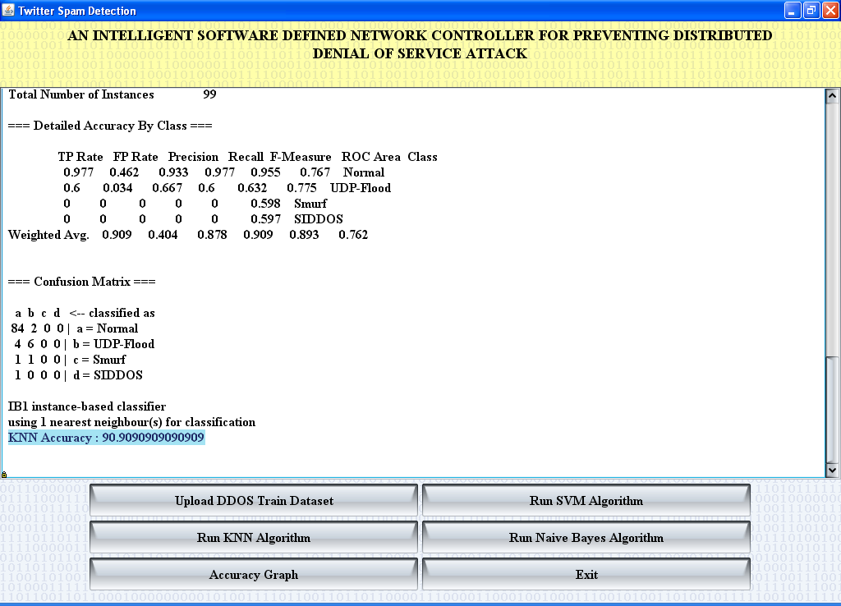
View Cluster Screen

Slide 29
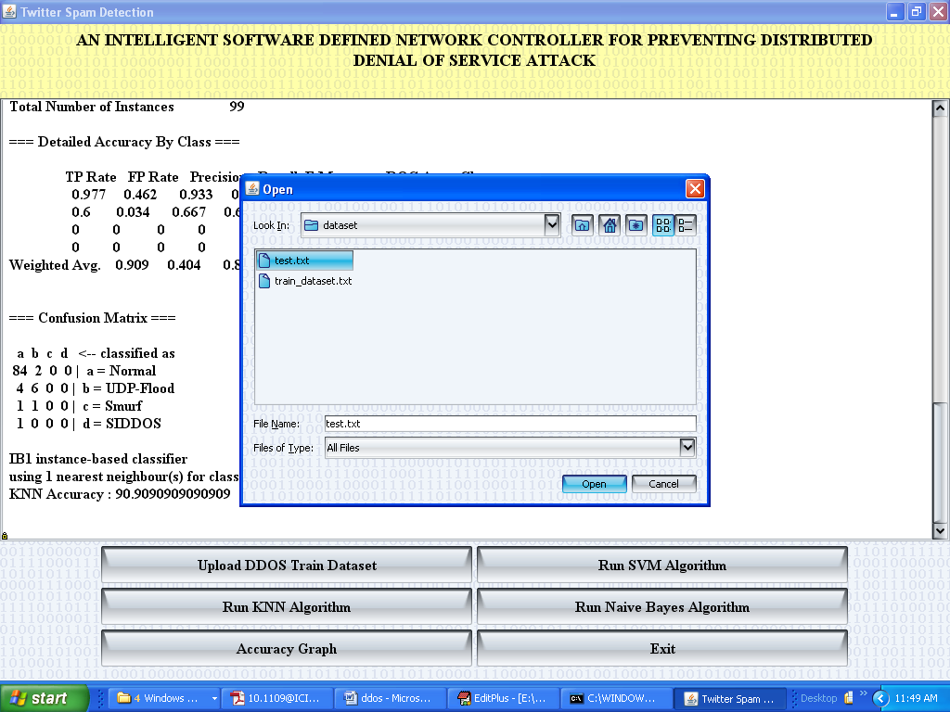

Slide 30
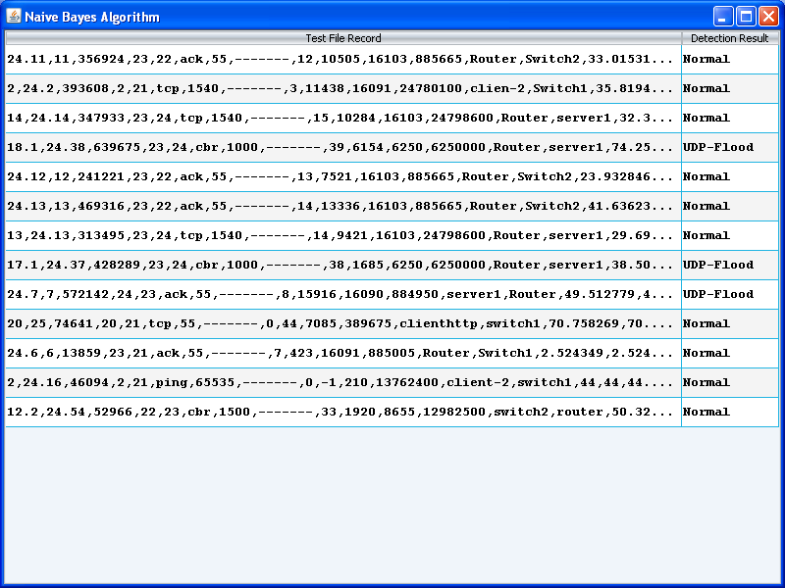

Slide 31
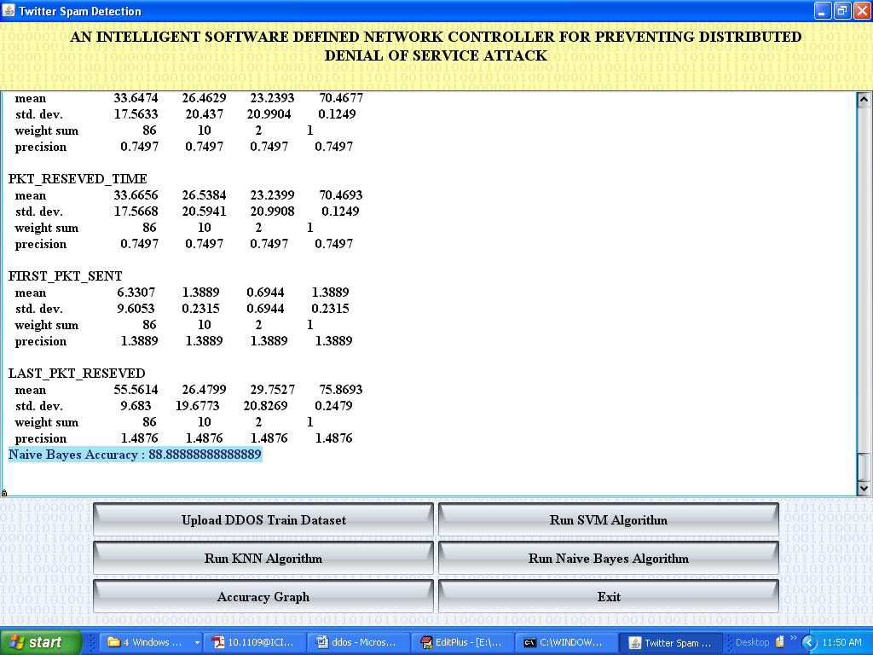

Slide 32
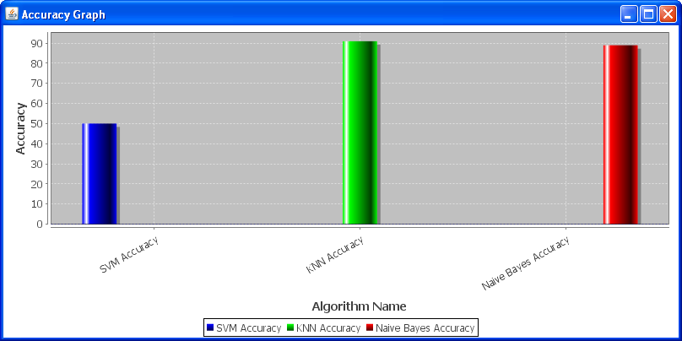
Accuracy Graph Screen

Slide 33
Conclusion
In this research work, the performance of Map- Reduce application is elaborated with respect to execution time and number of nodes. It is also verified that in Map- Reduce programming model as the number of nodes growing, the execution time is falling. In this way it has been shown that K-Mediod performs well and the results totally depend on the size of Hadoop cluster. The performance of above application has been depicted with respect to execution time, dataset size and number of nodes.

Slide 34
References
[1] Dave Beulke, Big Data Impacts Data Management: The 5 Vs of Big Data, November 2011.
[2] Apache Hadoop. http://hadoop.apache.org/
[3] Global Forensic Data Analytics Survey 2014, Big risks require big data thinking.
[4] Eileen McNulty, “Understanding Big Data: The Seven V’s”, May 22, 2014
[5] Mike Barlow,” Real-Time Big Data Analytics: Emerging Architecture”, February 2013.
[6] V. Laxmikanth, Managing Director, Broadridge Financial Solutions (India) Private Limited: “Getting Started with Greenplum for Big Data Analytics”, October 2013.

Slide 35
Thank You

